Slide 1
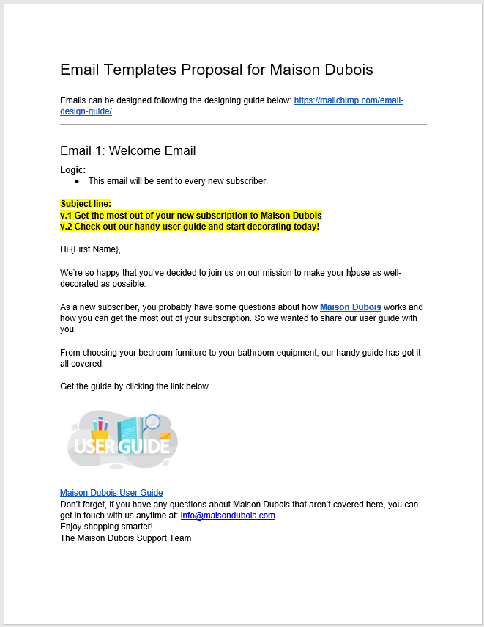
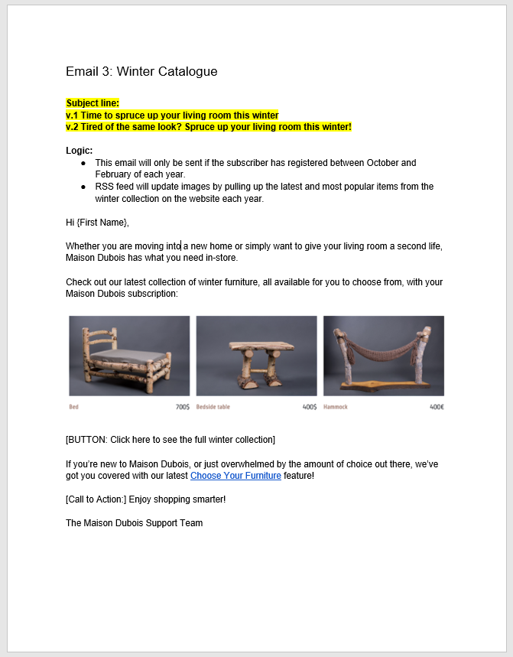
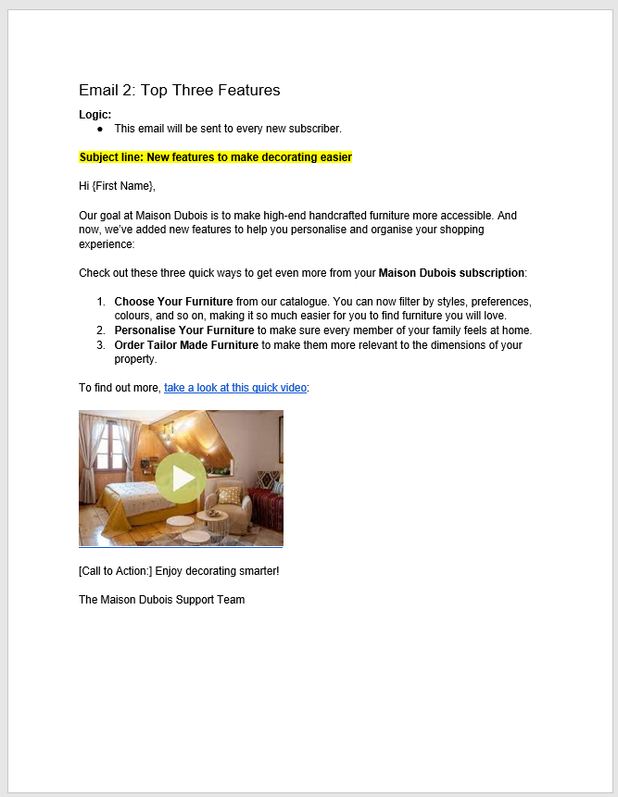
Email flow chart
Day
Day + 3
Day + 6
Subject: v.1 Get the most out of your new subscription to Maison Dubois
Welcome Email sent after audience subscribes to mailing list.
Subject: v.2 Tired of the same look? Spruce up your living room this winter!
Winter Catalogue to be sent 3 days after audience subscribes to mailing list.
Subject: New features to make decorating easier
New features sent 3 days after Winter Catalogue is delivered.

Slide 2

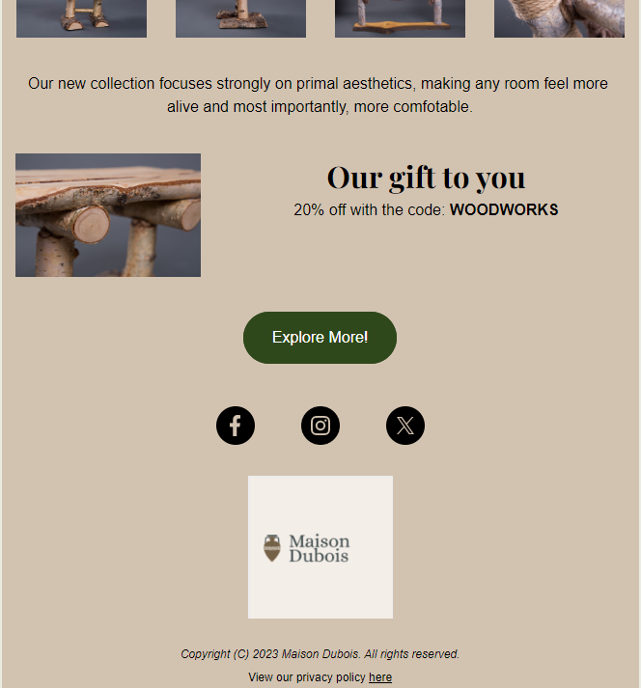

Email design for welcome programme (email 2 of 3)
Company Logo
Call to action
Social media links
Attention grabbing text
Information required under GDPR legislation

Slide 3
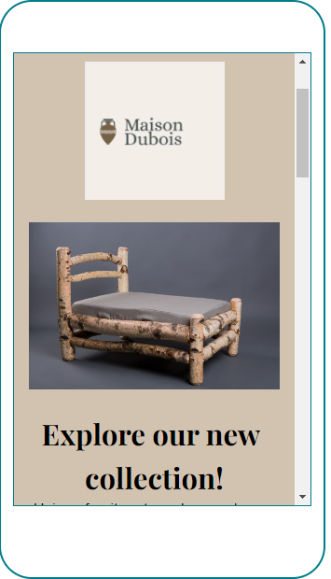
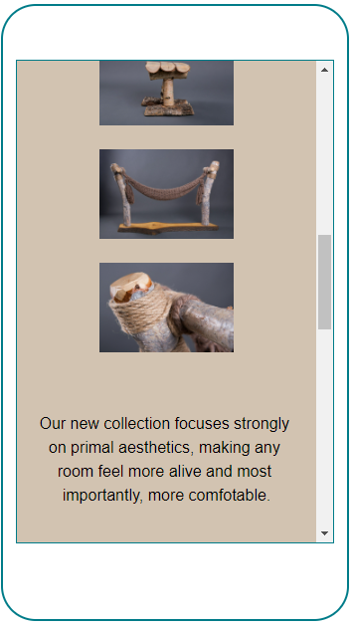
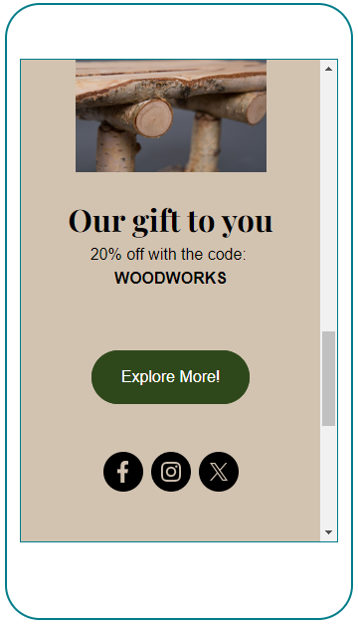
Email design for welcome programme (phone)

Slide 4
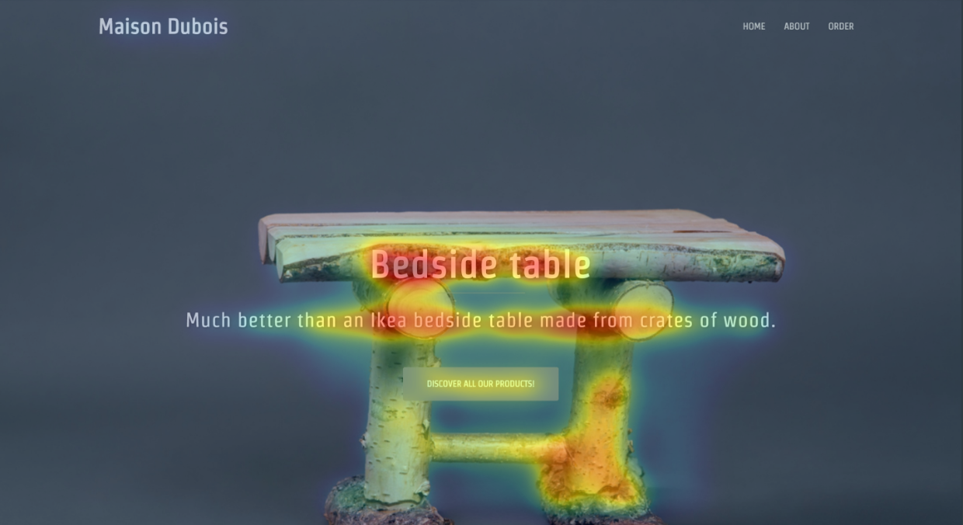
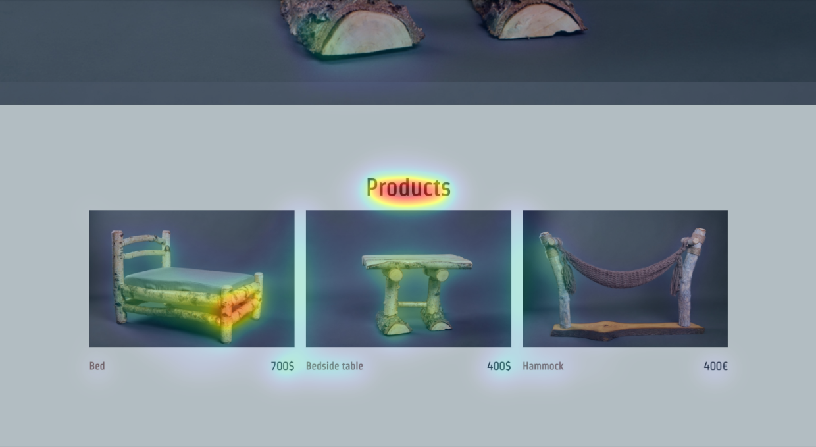
Heat Map Analysis
Activity around text
Attempts to interact with image

Slide 5

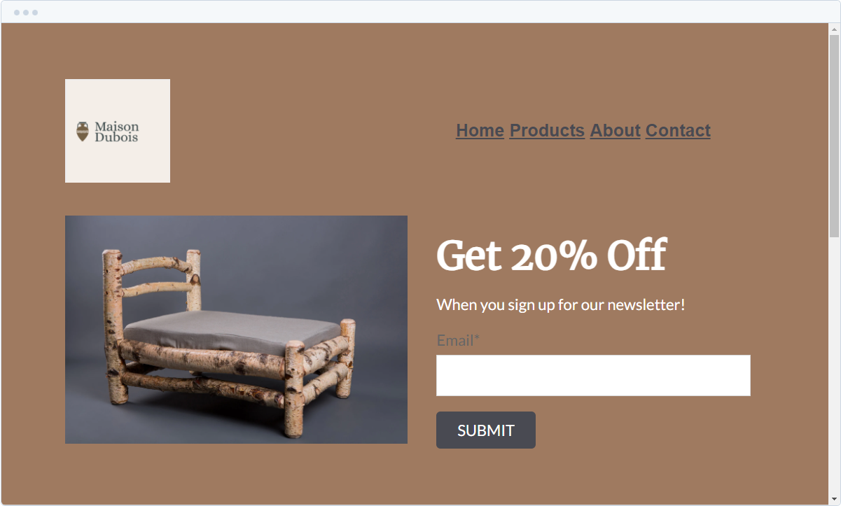
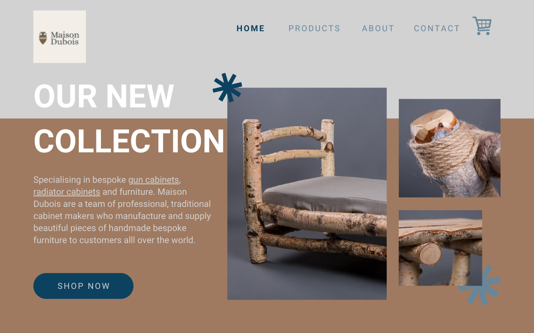
Landing Page

Slide 6
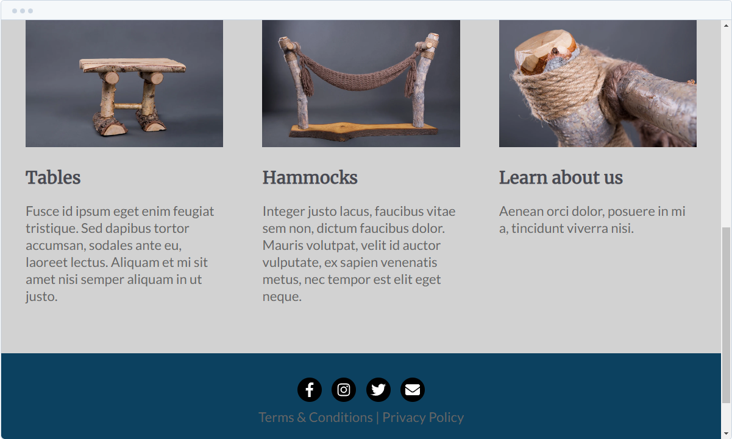
Landing Page

Slide 7
KPI’s
Open Rate – How often are the emails being opened and at what point?
Click-Through Rate – How many people are finding their way to the website?
Conversion Rate – What percentage of subscribers are buying products?
Landing Page Conversion Rate – how many website visitors are subscribing?

